Slide 1
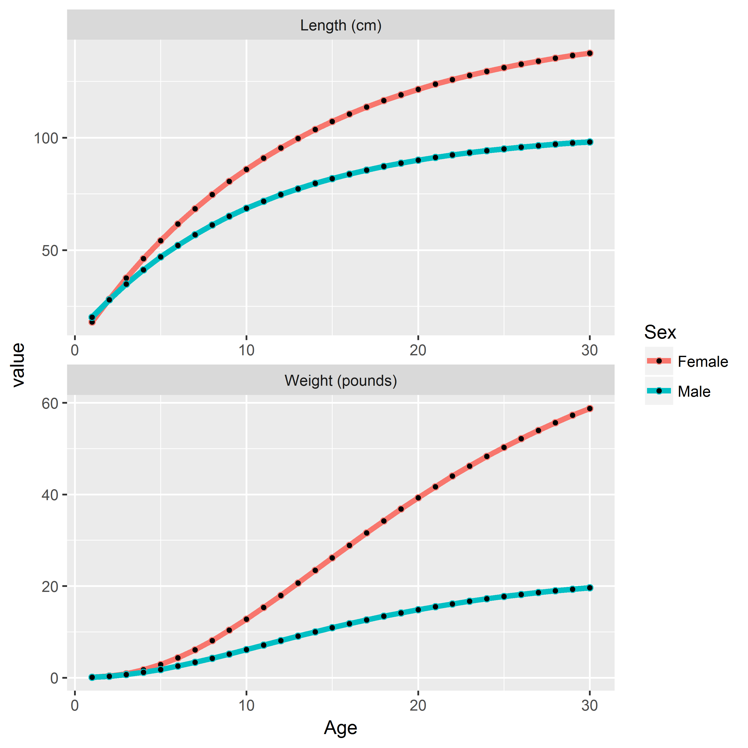


Length and Weight at Age
$l_{a}=l_{∞}\left(1−exp\left(−k\left(a−t_{0}\right)\right)\right)$*$e^{ε_{l}}$
$$w_{a}={α\left(l_{a}\right)}^{β}∗e^{ε_{w}}$$

Slide 2
Time-varying Growth
Female
Male
Female Male
Age-5
Age-10
Age-15
Sullivan and Kruse (in prep)

Slide 3
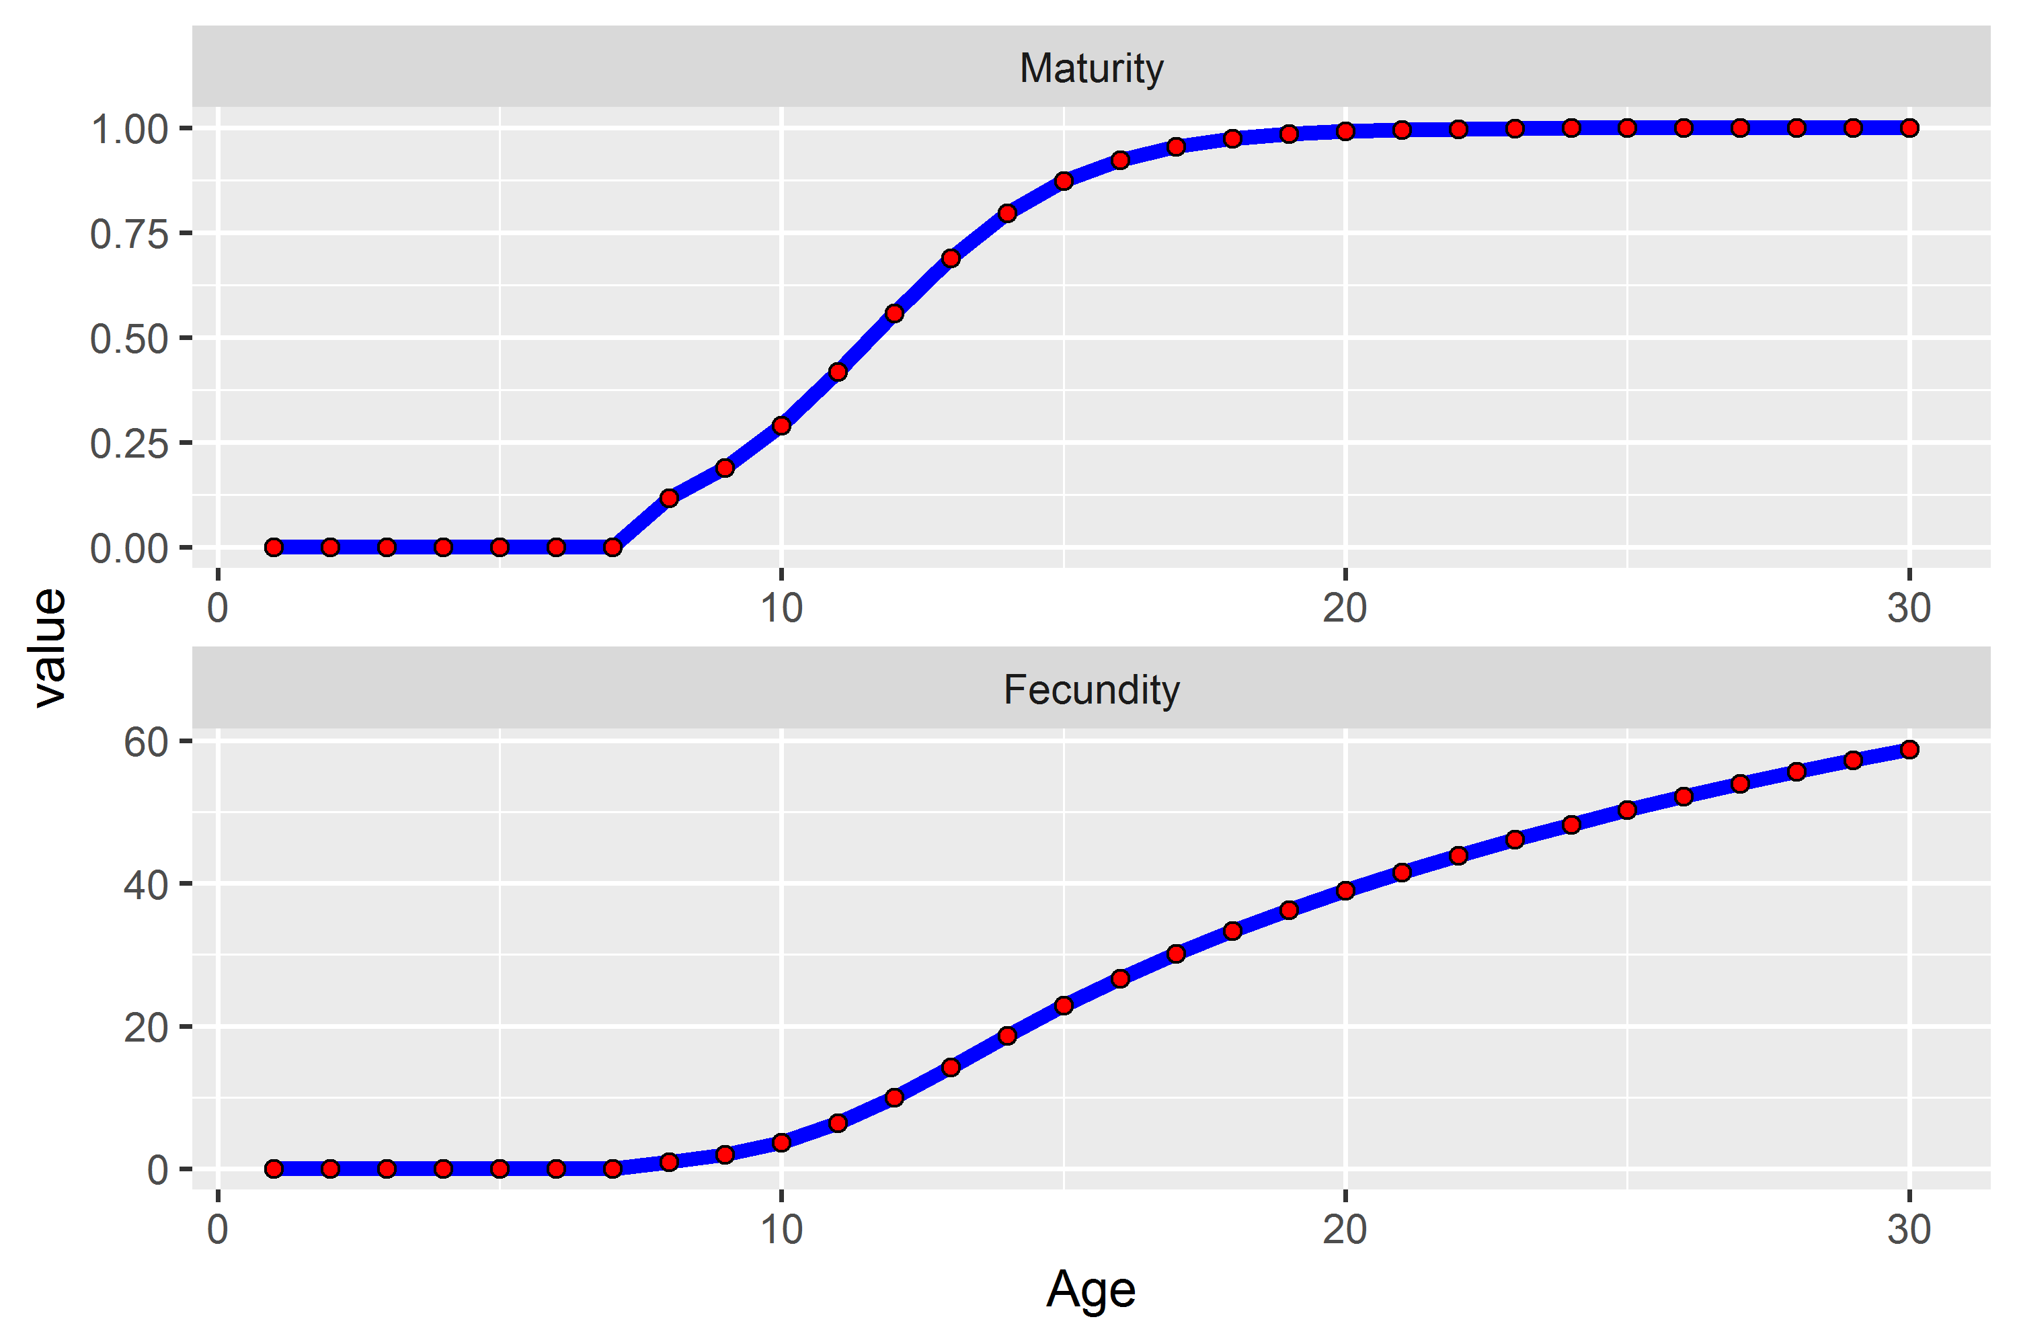


Maturity and Fecundity
$$m_{a}=\frac{1}{1+exp\left(−\left(a−a_{h}\right)/g_{h}\right)}$$
$$f_{a}=m_{a}w_{a}$$

Slide 4
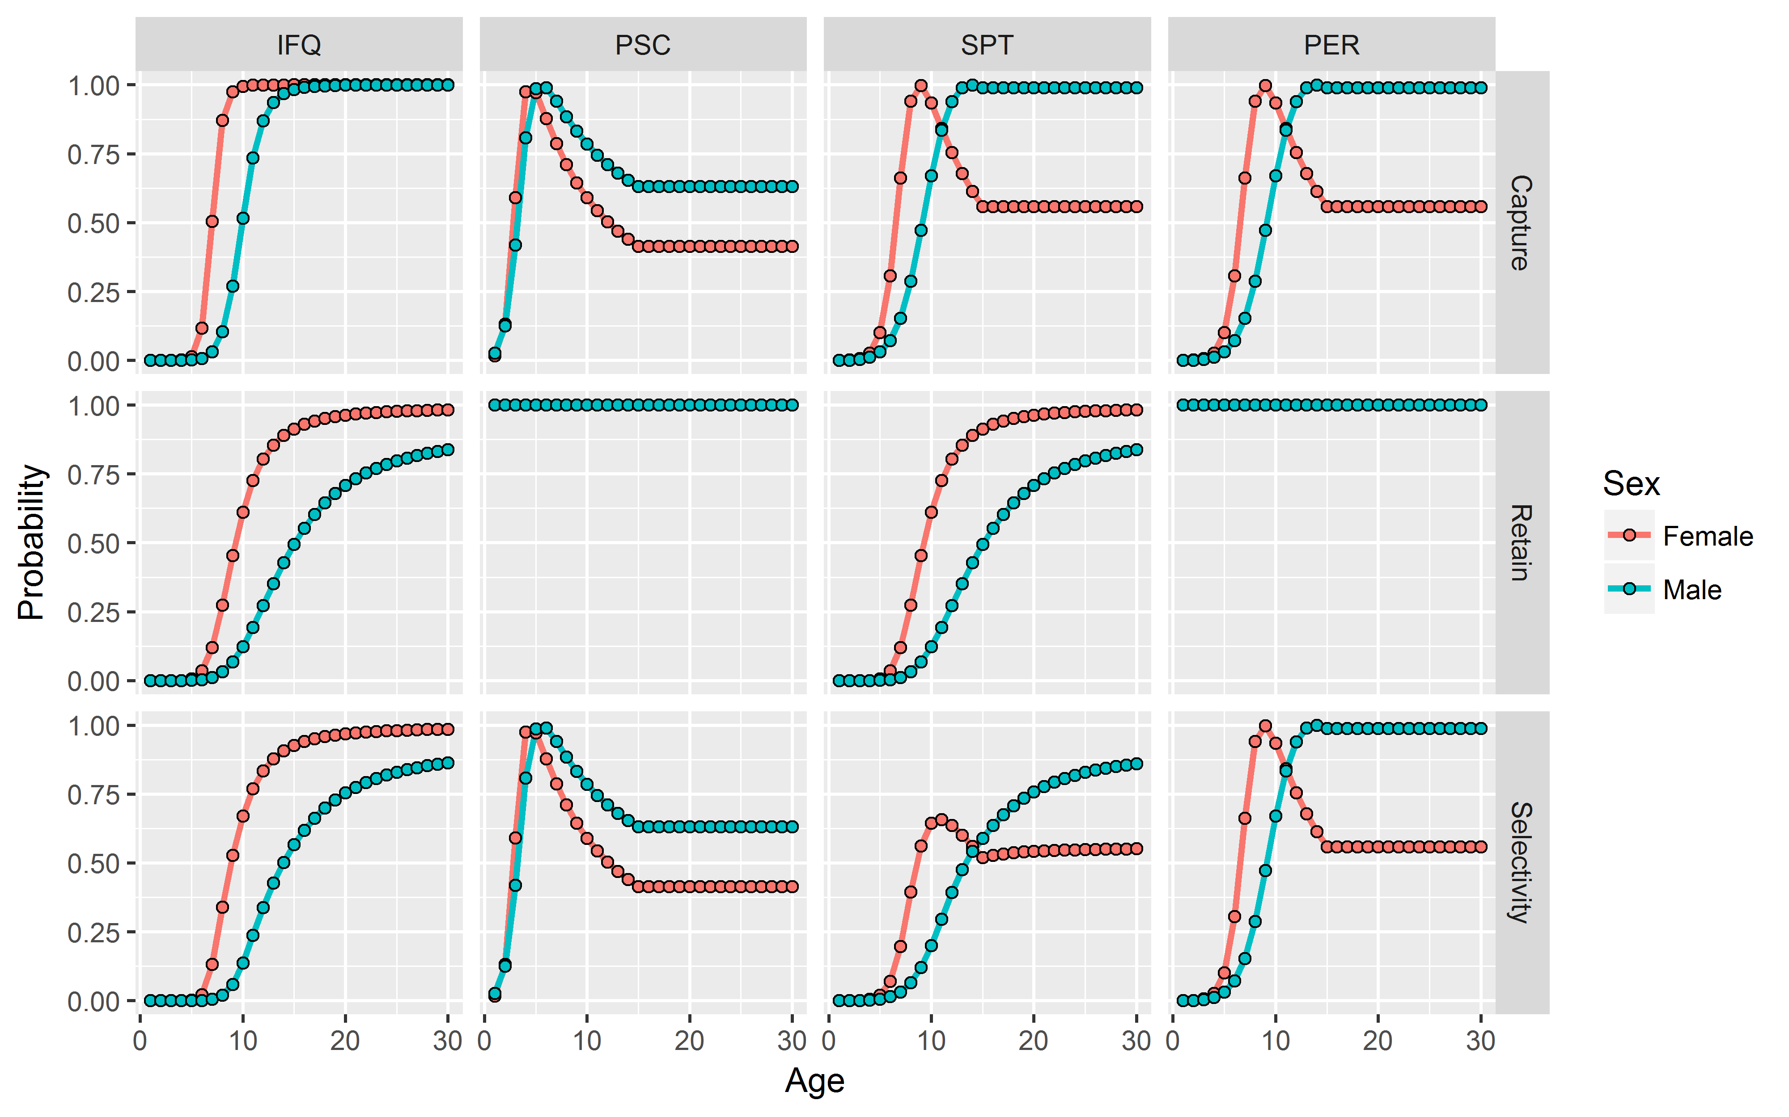
Selectivity

Slide 5
Moving Forward
Fishing Mortality
Decision rules… F47%
Implementation uncertainty
Ensemble assessment model uncertainty
Recruitment
Current steepness
Initial SSB
Historical: 400-600 Mlb
Current: 153-286 Mlb
Specific management areas?

